Slide 1
“Procedural generation”
A review of the recent literature
IRDC 2016 Sofia, Bulgaria
Tom Ford
Oxford, United Kingdom

Slide 2

Where to start & where to end?
Procedural Game Content Generation: A Survey
  Hendrikx, M., Meijer, S., van der Velden, J., and Iosup, A.
  ACM Trans. Multimedia Comput. Commun. Appl. -, -, Article 1 (February 2011)
Procedural generation of dungeons
  Roland van der Linden, Ricardo Lopes and Rafael Bidarra
  IEEE Transactions on Computational Intelligence and AI in Games ( Volume: 6, Issue: 1, March 2014 )
Procedural Content Generation in Games
  Noor Shaker, Julian Togelius, Mark J. Nelson
  Springer; 1st ed. 2016 edition (October 19, 2016)
  http://pcgbook.com/
Notes:
Textures – e.g. Perlin noise
Derived content – e.g. MVP shots

Slide 3
“Relating story and space”
A couple of interesting papers
IRDC 2016 Sofia, Bulgaria
Tom Ford
Oxford, United Kingdom

Slide 4
Two papers to review
Adventures in Level Design
  J. Dormans (2011)
  Proceedings of the 2010 Workshop on Procedural Content Generation in Games
  Monterey, California — June 18 - 18, 2010
Toward supporting stories with procedurally generated game worlds
  Ken Hartsook, Alexander Zook, Sauvik Das, and Mark O. Riedl (2011)
  2011 IEEE Conference on Computational Intelligence and Games (CIG)

Slide 5
Questions to address
How are the story of a game and its game world interlinked?
How can the story and the world be generated?
Is the generation process influenced by the interlinking of story and game world?

Slide 6
Adventures in Level Design
Adventures in Level Design
  J. Dormans (2011)
  Proceedings of the 2010 Workshop on Procedural Content Generation in Games
  Monterey, California — June 18 - 18, 2010

Slide 7
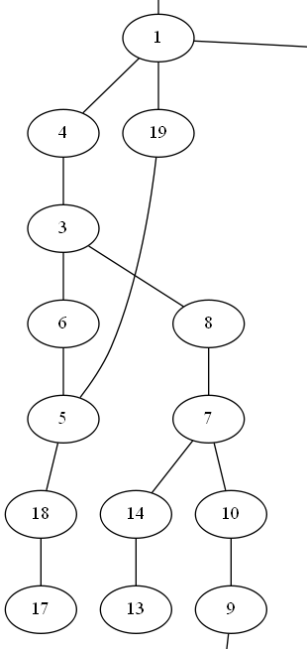
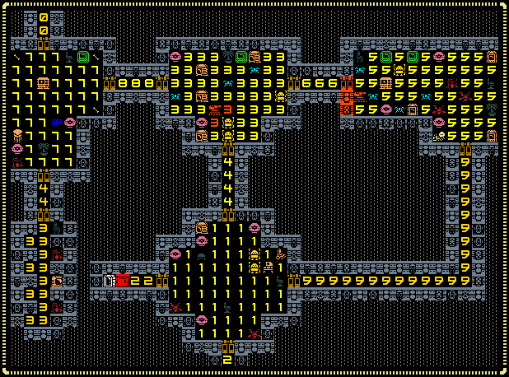
Mission and space graphs
Dormens (2011) introduces new concepts or vocabulary
Mission graph
Space graph
Exit
Open lock
Find key
Fight monster
Enter

Slide 8
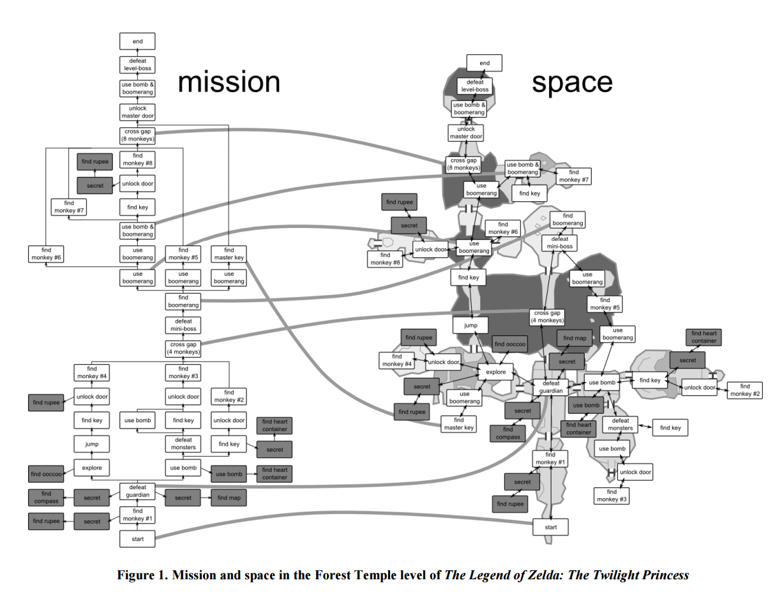
Legend of Zelda: The Twilight Princess
Notes:
Isomorphic start of the game
Non-isomorphic parts, for example find boomerang, use boomerang, find master key
Hub and spoke aspect, with backtracking (metrovania style)

Slide 9
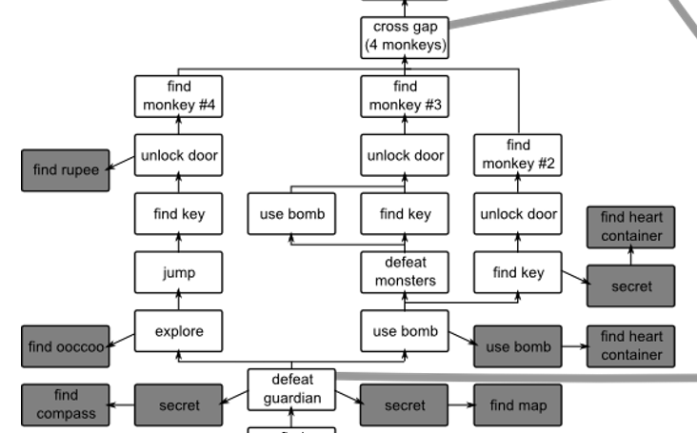
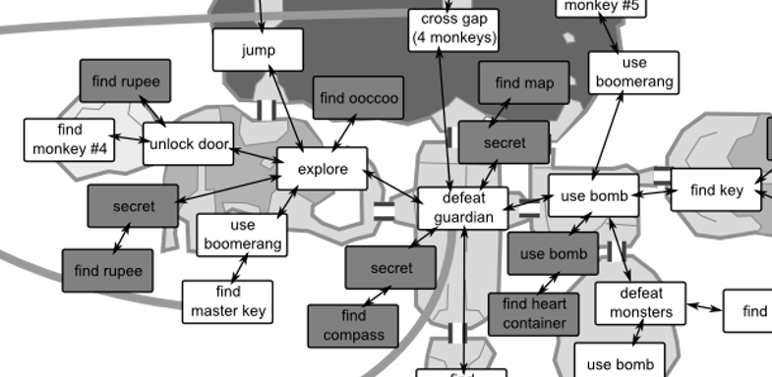
mission
space

Slide 10
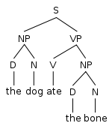
Generative grammars
Originate in linguistics [Chomsky]
Alphabet and rules
Employs rewriting to build phrases
Rules
S → NP + VP
NP → D + N
VP → V + NP
Notes:
D - determiner

Slide 11
Generative grammars for mission graph
Use generative grammars to procedurally build a mission
Using a set of rules
1:S
1:e
2:C
3:g
Code | Meaning
C | challenge
S | start
e | entrance
m | monster
h | hazard
g | goal
1:C
1:m
1:C
1:h
Squares are non-terminals (get replaced)
Circles are terminals

Slide 12
Example of a simple mission graph
Select replacements at random
1:S
1:e
2:C
3:g
Code | Meaning
C | challenge
S | start
e | entrance
m | monster
h | hazard
g | goal
1:e
2:m
3:g
Done
Rules
1:C
1:m
1:C
1:h

Slide 13
More complex mission graph
Rule set
1:S
1:e
2:E
3:F
4:bm
5:g
Code | Meaning
C | challenge
E / F | explore
S | start
bm | boss monster
e | entrance
f | fork
j | join
m | monster
h | hazard
g | goal
1:E
2:F
1:C
2:C
3:C
1:E
2:F
1:f
2:j
4:C
1:C
1:m
1:C
1:h

Slide 14
Example of a more complex mission graph
1:S
1:e
2:E
3:F
4:bm
5:g
6:C
Code | Meaning
C | challenge
E / F | explore
S | start
bm | boss monster
e | entrance
f | fork
j | join
m | monster
h | hazard
g | goal
1:e
2:f
3:j
4:bm
5:g
7:C
6:m
1:e
2:f
3:j
4:bm
5:g
7:C
6:m
1:e
2:f
3:j
4:bm
5:g
7:h
Done

Slide 15
Other mission graph considerations
Recursive rules possible
Can apply heuristics to the random choice
Different rule sets can give different feels to different areas
Apply meta-generation effects
  Increasing difficulty
3:E
4:F
1:E
2:F
1:f
2:j
5:E
6:F
1:e
2:E
3:F
4:d
5:E
6:F
7:g
Difficulty 1
Difficulty 2

Slide 16
Generative grammars for space graph
Build space / map using grammar
Example rule set
c
c
c
c
c
c

Slide 17
Creating a space graph with a grammar
c
c
c
c
c
c
c
c
c
c
c
c
c
c
x2
Done
c

Slide 18


Generating the space from the mission
Link the mission and spatial graphs by generating the space graph from the mission graph
Associate a node in the mission graph with a node (room) in the space graph
1:m
c
1:h
c

Slide 19
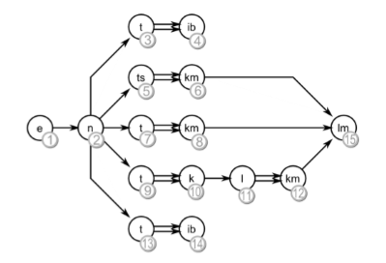
Worked example from the paper
Translating the mission graph into a space graph
Double arrows represent coupled space nodes (e.g. an item behind a test)

Slide 20
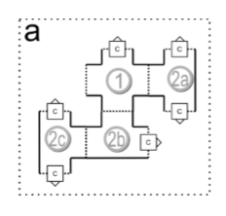
Worked example from the paper
Map each mission node to a spatial node or nodes
Place each new spatial node at a random growth point

Slide 21
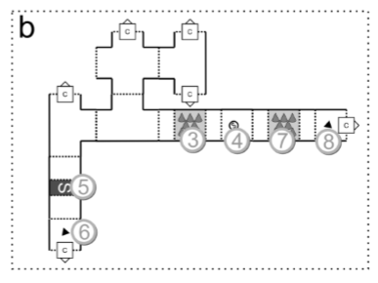
Worked example from the paper

Slide 22
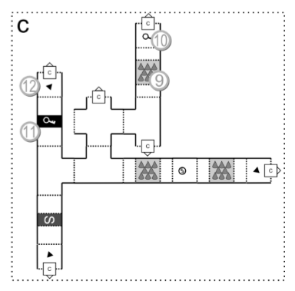
Worked example from the paper

Slide 23
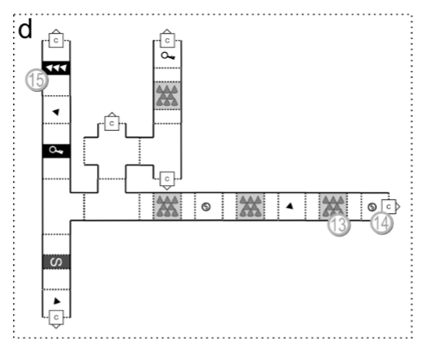
Worked example from the paper

Slide 24
Pros and cons of this approach
Pros
  Generates very complex missions and game worlds
  Sequential (e.g. key / lock puzzles) can be created and are always solvable
  Support for meta-spatial game effects, e.g. Increasing difficulty
Cons
  Semi-random placement of rooms
    Lack of long-range order breaks mission flow and makes large levels chaotic
    Back-tracking is uncontrolled
  Spatial graph algorithm produces no loops (loops can be added but risks short-circuiting mission)
Improvements
  Add heuristics for spatial graph growth
    e.g. close all open spatial nodes when passing significant milestone
  Consider a hub (loop)-spoke model as the foundation of the spatial graph

Slide 25
Toward supporting stories with procedurally generated game worlds
Toward supporting stories with procedurally generated game worlds
  Ken Hartsook, Alexander Zook, Sauvik Das, and Mark O. Riedl (2011)
  2011 IEEE Conference on Computational Intelligence and Games (CIG)

Slide 26
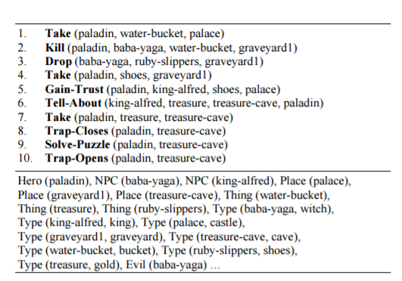
Defining a story
Take a hand-made or computer-generated story
  (e.g. An Offline Planning Approach to Game Plotline Adaptation http://www.cc.gatech.edu/~riedl/pubs/li-aiide10.pdf)
Story consists of: NPCs, Places, Things, Types
Equivalent to the mission graph
  Linear, no branches

Slide 27
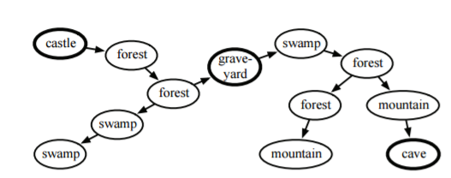
Basic spatial graph
Islands (plot centres) and bridges (terrain)
Islands always appear on a single path through the graph
Islands always appear in the order that they first appear in the story
  Very restrictive but does give a degree of long-range order

Slide 28
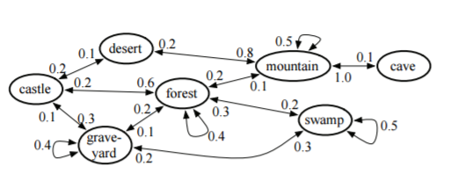
Optimising the spatial graph
Apply designer (and player) preference to map generation
  Distance between plot centres (islands)
  Degree of branchiness
  Terrain transition likelihood
Use genetic algorithm to evolve random spatial graphs

Slide 29
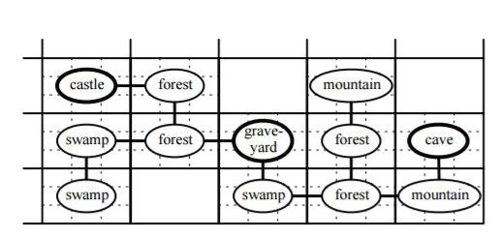
Constraining the spatial graph
Graph needs to map on a 2d game map
  Engine requirement
Recursive backtracking to find a solution
  Constrain original space graph to have no more than 2 children per node
If no solution available, regenerate space graph

Slide 30
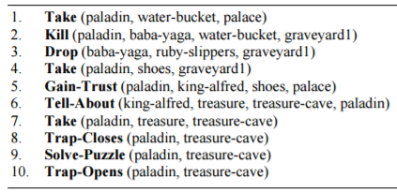
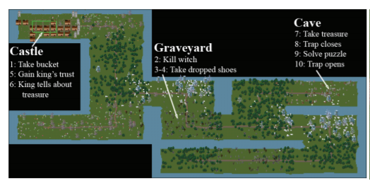
Example spatial graph

Slide 31
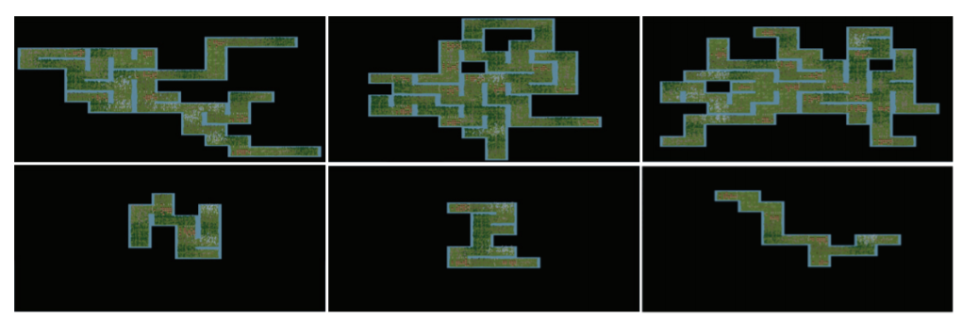
Spatial graphs optimised for different parameters
Larger world, more branches
Smaller world, fewer branches

Slide 32
Pros and cons of this approach
Pros
  Uses optimisation algorithms to create more optimal maps based on designer parameters
  Deals with graph -> 2d space mapping
  Enforced long-range mission order in game world
Cons
  Only supports very simple linear missions
  No consideration of back-tracking, game world loops etc.
Improvements
  Adopt more complex mission graphs
  Extend optimisation to mission parameters (e.g. back-tracking, side-quest proximity etc.)

Slide 33
Summary
Dormens (2011) provides a useful vocabulary to discuss the field – mission and spatial graph
Hartsook (2011) shows the value of optimisation approaches
Both papers aim to derive a game world (spatial graph) from a story (mission graph) which seems natural
Both papers highlight that sophisticated heuristics are needed to build levels compelling enough for use in an actual game

Slide 34
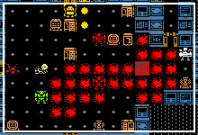
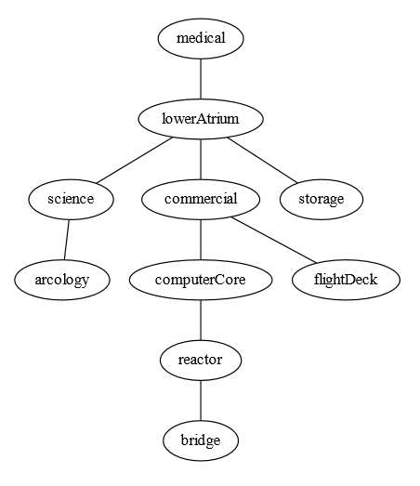
Why am I so interested?
TraumaRL (2014) was my procedural action adventure game
Complex mission graph
  Multiple step missions
  Side quests
  “Personnel log”-style clues
  Key / lock-style puzzles
Great as a 7DRL but how do I extend and generalise missions and maps?
Can I apply the vocabulary of Dormens (2011) to TraumaRL?

Slide 35
TraumaRL spatial graph(s)
Spatial graph is the map, but it is generated through higher level concepts
Level connectivity
Room connectivity
Game map

Slide 36
TraumaRL mission graph (simplified)
Start
medical
Find armoury key
Destroy cameras
medical
medical
Open armoury
Unlock atrium elevator
Find armoury key
Find transponder
Find environmental suit
Find bridge key
not arcology
atrium
Open armoury
Jam transmitter
(optional)
(omitted – on each level)
science / storage
Unlock arcology elevator
Unlock bridge
Find computer core key
arcology
Unlock computer core
computer core
Destroy computer nodes
Enable self-destruct
constrained location
bridge
Activate self-destruct
reactor
Escape in shuttle
shuttle bay

Slide 37
Mission graph overlaid on spatial graph
Spatial graph generated first then mission graph “overlaid”
  Opposite of both papers
Traditional level generation first (spatial graph)
  Use established roguelike level building techniques
  Standard levels then linked with elevators
  Mission ordering of levels is hard-coded (never have to pass through a harder/later in mission level to get to an earlier one)
Mission generation second (implicit mission graph)
  NPCs, keys, logs placed in existing rooms, locks on existing doors
  Existing empty rooms are swapped with mission-specific templates
  Extra quest-specific rooms can be added onto unused doors (Trauma2 engine)

Slide 38
Learning from the literature in Trauma2
Build a real mission graph first and use it to influence the spatial graph
Substitute parts of the main quest
  Medical elevator locked by a key rather than cameras
  Use a generative grammar approach?
Replace hard-coded constraints on level connectivity with constraints derived from mission graph
  Mission graph difficulty nodes influence level connectivity?
Replace semi-hardcoded constraints on spatial positioning of quests with constraints derived from mission graph
  Which quests on which levels
  Mission graph depth maps to level depth?

Slide 39
Final summary
Reading the literature has helped me think more clearly about my existing roguelike engine
Good techniques and ideas in the literature
...but no ready-made engines

Slide 40
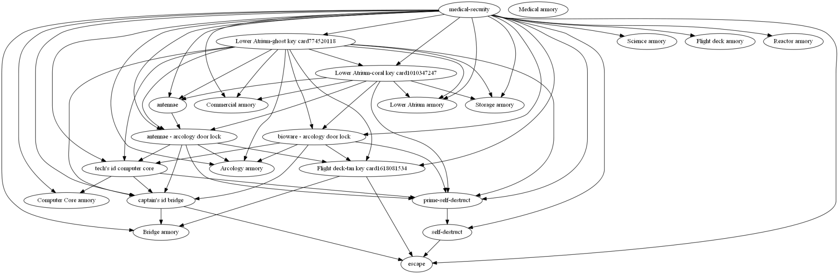
Complex Mission graph
An actual TraumaRL mission graph rendered by GraphViz
This is derived by the engine post-hoc (i.e. from the placement of keys, locks and objectives)

Slide 41
Disclaimers
Doryens (2011)
  Permission to make digital or hard copies of all or part of this work for personal or classroom use is granted without fee provided that copies are not made or distributed for profit or commercial advantage and that copies bear this notice and the full citation on the first page. To copy otherwise, to republish, to post on servers or to redistribute to lists, requires prior specific permission and/or a fee
  PCGames 2010, June 18, Monterey, CA, USA Copyright 2010 ACM 978-1-4503-0023-0/10/06... $10.00

